Slide 1
Better Delivery. Better Exploits.
Building an encoder for fun and knowledge

Slide 2
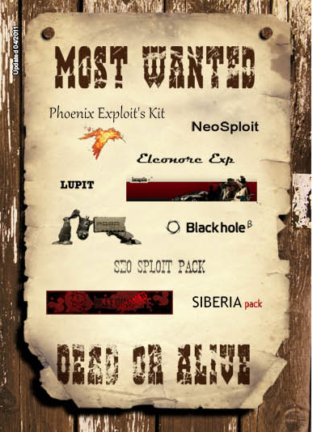
Kits, who knows em?

Slide 3
One Step Behind
Analysts
Kit Creators
Adapt
Discover exploits
Write specialized tools
Wait
Follow
Adjust
Use/port exploits
Circumvent current tools
Attack
Lead

Slide 4


In Other Words
Kit Creators
US
THEM

Slide 5
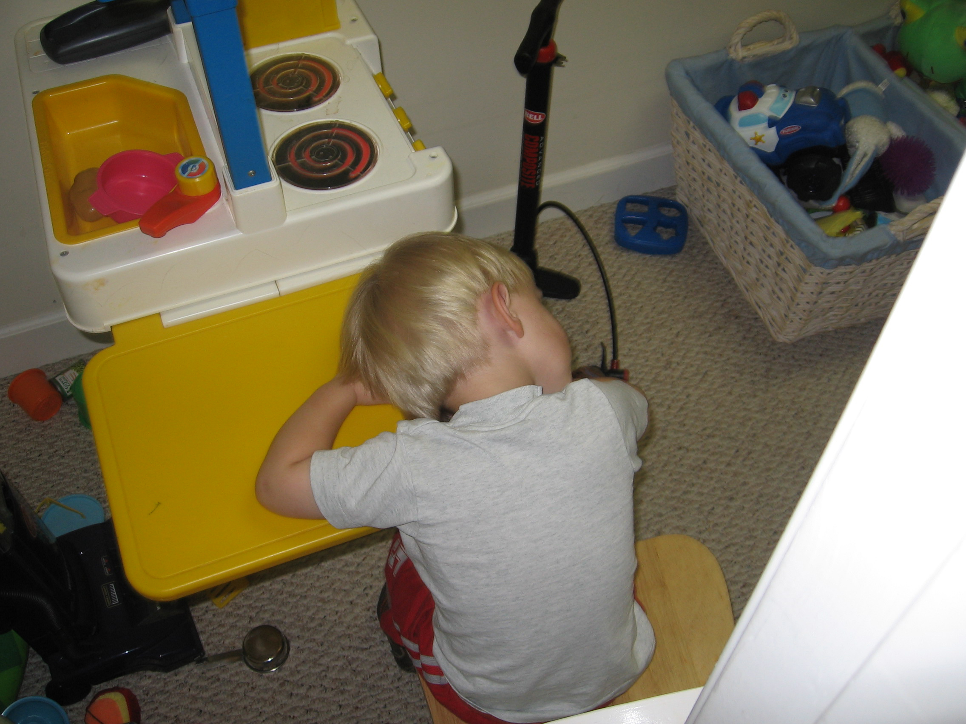
Our Average Competitor
Lazy
Hardly a developer
Slow
Content
Not super technical
… you get the idea

Slide 6


Spark New Detections

Slide 7
Better Obfuscation
Split code across several files
Make use of 3rd-party libraries
Remove offline deobfuscation
Break automated scanners and parsers
Switch routines
Use browser features
… and lastly…

Slide 8

REMAIN
AGILE
MY
FRIENDS

Slide 9

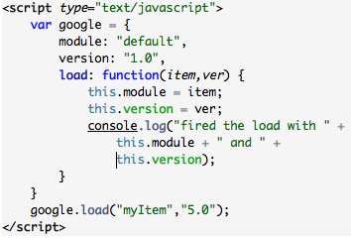
Impersonate Good
Google
Evil

Slide 10
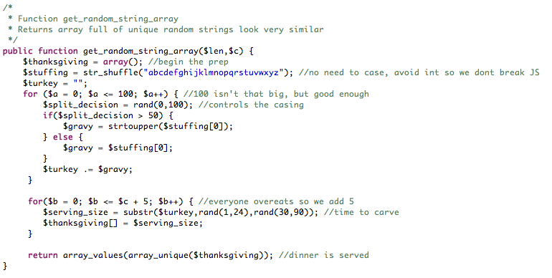
Variable Names
Creates:
vvVVVVVVVVVvvvvVVV
vvvvvvvVVVVVVVVVvvvvVVVVvvVVVVVVVVVVVVVVVVvvvv

Slide 11
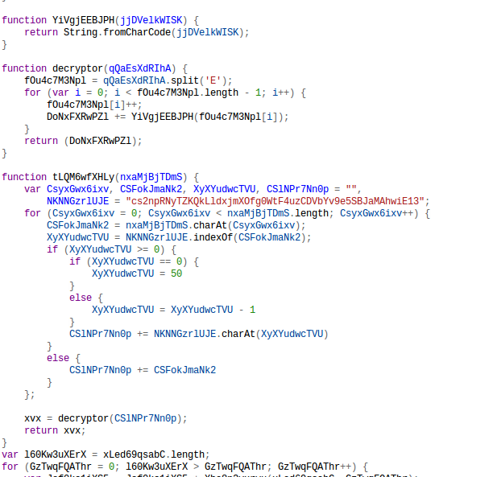
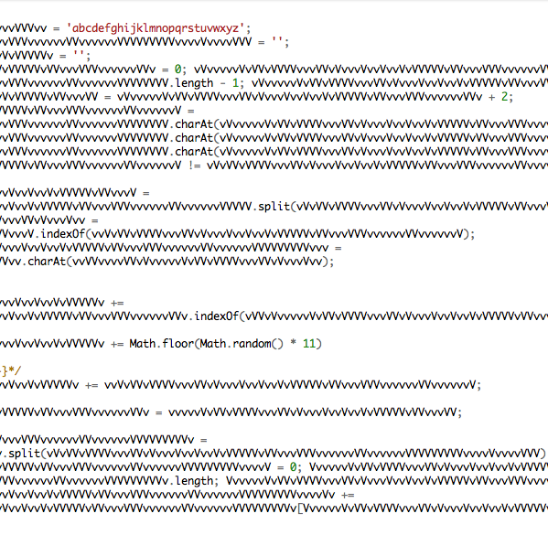
Can’t easily find/replace variable names
Certain letters make it extremely difficult to read the code
Long variables ensure variables will be contained within other variables
Easy to adjust and change
Old and Abused
New and Improved

Slide 12
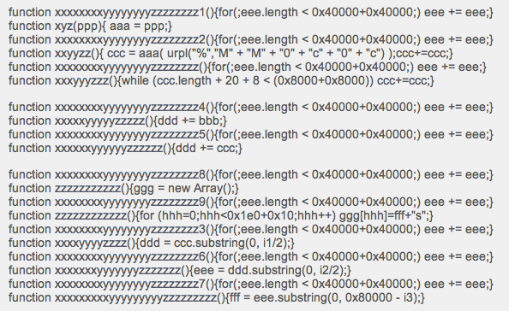
Thanks 2011-2462 0ay

Slide 13
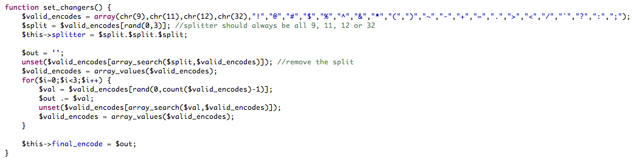
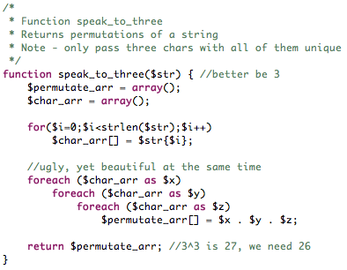
Payload Masking

Slide 14
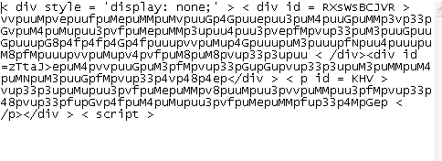
ASCII <3 9,11,12,32
Old and Abused
New and Improved

Slide 15
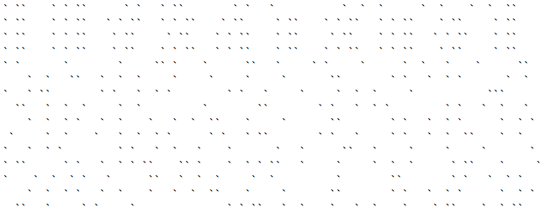
Blank spaces are harder to detect
Invisible characters make copy and paste scary
Represent the entire lower case alphabet with three unique characters
Easy to adjust and change
Old and Abused
New and Improved

Slide 16
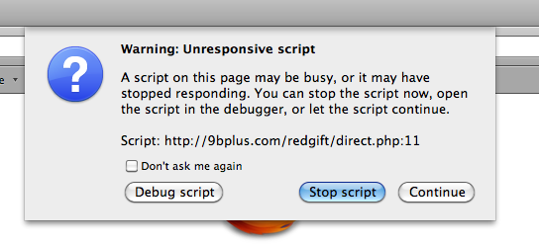
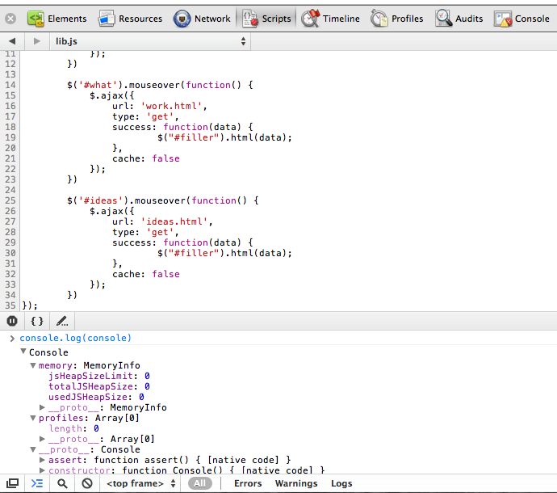

Preemptive Hooks
Dumping the Objects
Dumping the Browser

Slide 17
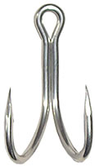
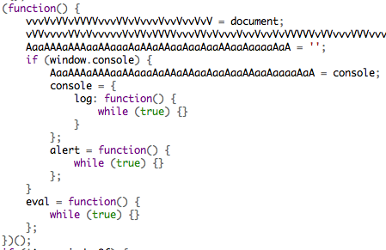
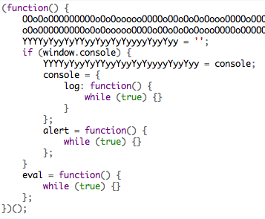
Double Hooking
Round One
Round Two
Clobbers hooks that would normally show data
For each round, functions are clobbered again
Payload for each hook can be adjusted – Example – slow recursion puts the browser on life support

Slide 18
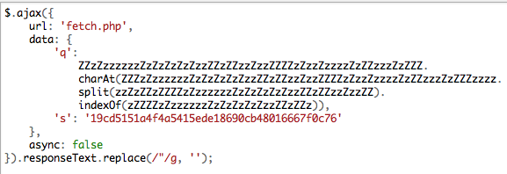
Bound by AJAX

Slide 19
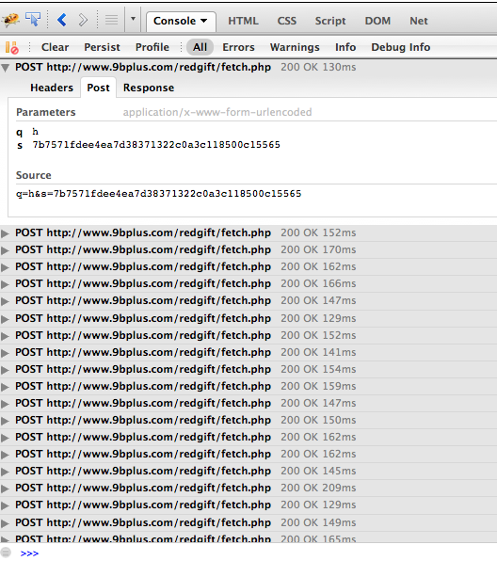
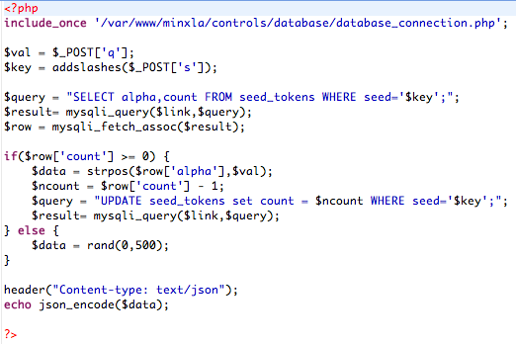
Caller and Receiver

Slide 20
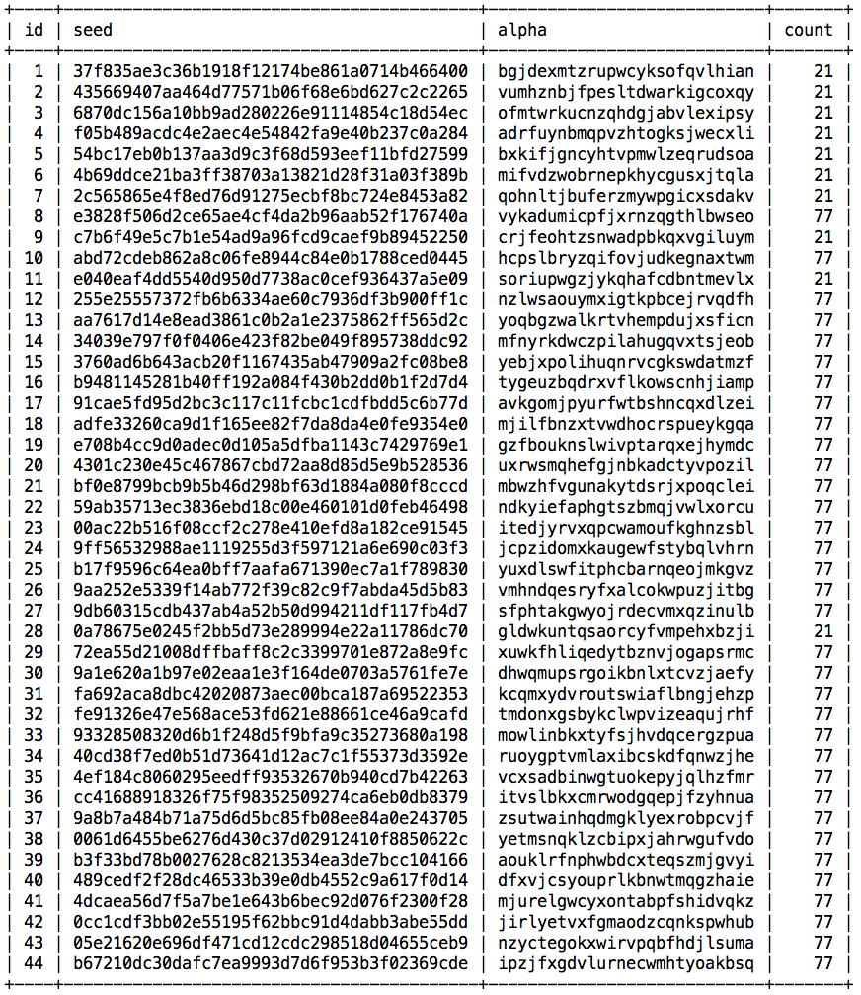
AJAX + Call Limit = Hell
HTTPS the site and no one can inspect your AJAX sent (of course they can’t see the JS either)
Limit the calls on the AJAX URL for that given key – push over the count and you get skewed returns
Scanners and Engines don’t follow AJAX calls
Can’t remove it from the live page
One-time delivery
Hidden in the second stage

Slide 21

Rapid One-time Instances
Server handler is dynamically created when user hits page
Request is made from the encoder to delete the handler in 10 seconds
Code runs before the deletion

Slide 22
Except These
Old-school technique (fixed on some engines)
Leverage jQuery since most engines don’t
Throw working code in the exception to confuse
try {
$(); //save us jQuery
//nasty, nasty
} catch (e) {
//return dorked code
}

Slide 23
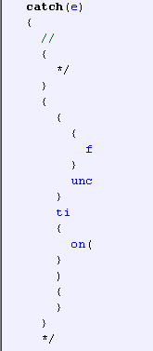
Comment Bombs
//{*/}{{{f}unc}ti{on(}){}}*/
try { //{*/}{{{f}unc}ti{on(}){}}*/
call(); } catch(e) { //{*/}{{{f}unc}ti{on(}){}}*/
Results vary – Malzilla =>

Slide 24
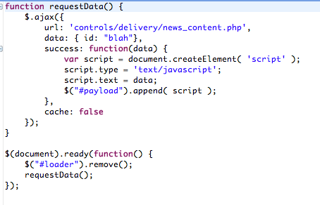
Complete Evasion
If We Succeed,
What’s In Data?

Slide 25
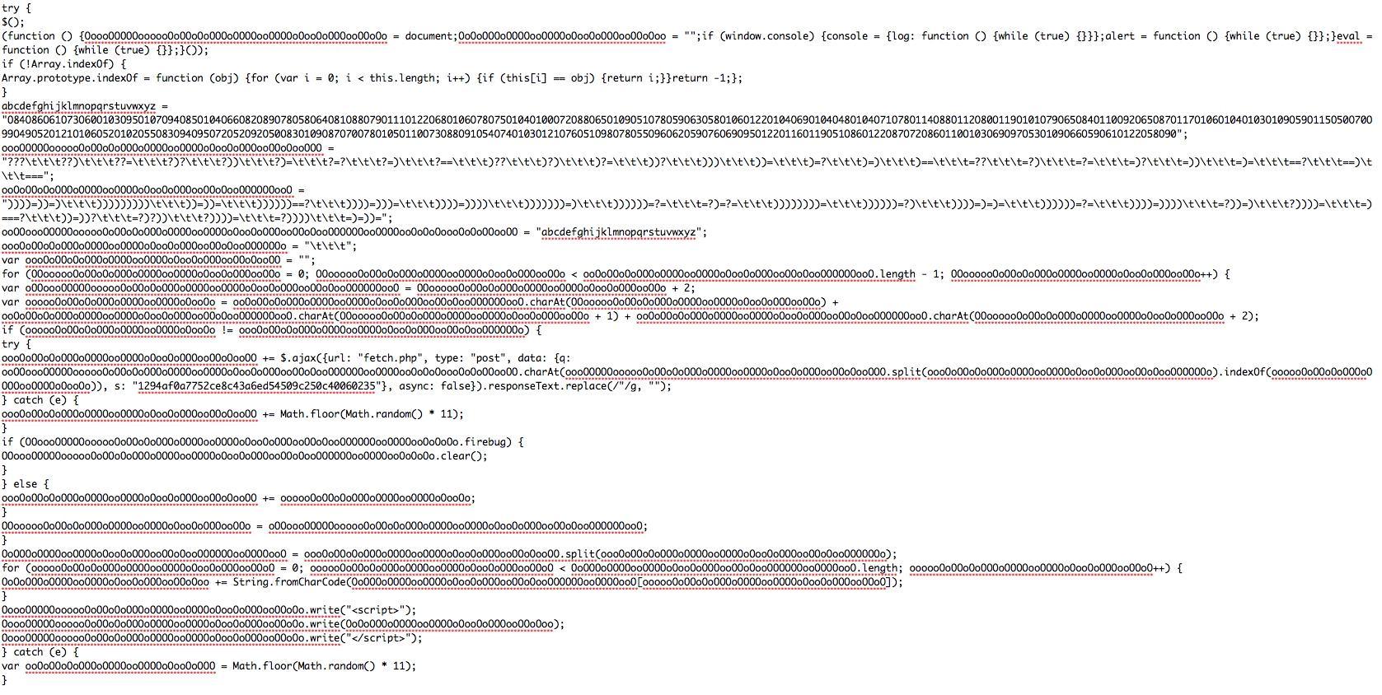
}:-)

Slide 26
Needs Work
Chrome and Safari run fine!
  No trace in the DOM
  Ability to add tokens, swap the delivery URL, etc.
Delivering an obfuscated payload that makes use of AJAX through AJAX causes issues
  Firefox goes into a coma
  IE 6 & 7 completely bomb and 8 crashes in the tab

Slide 27
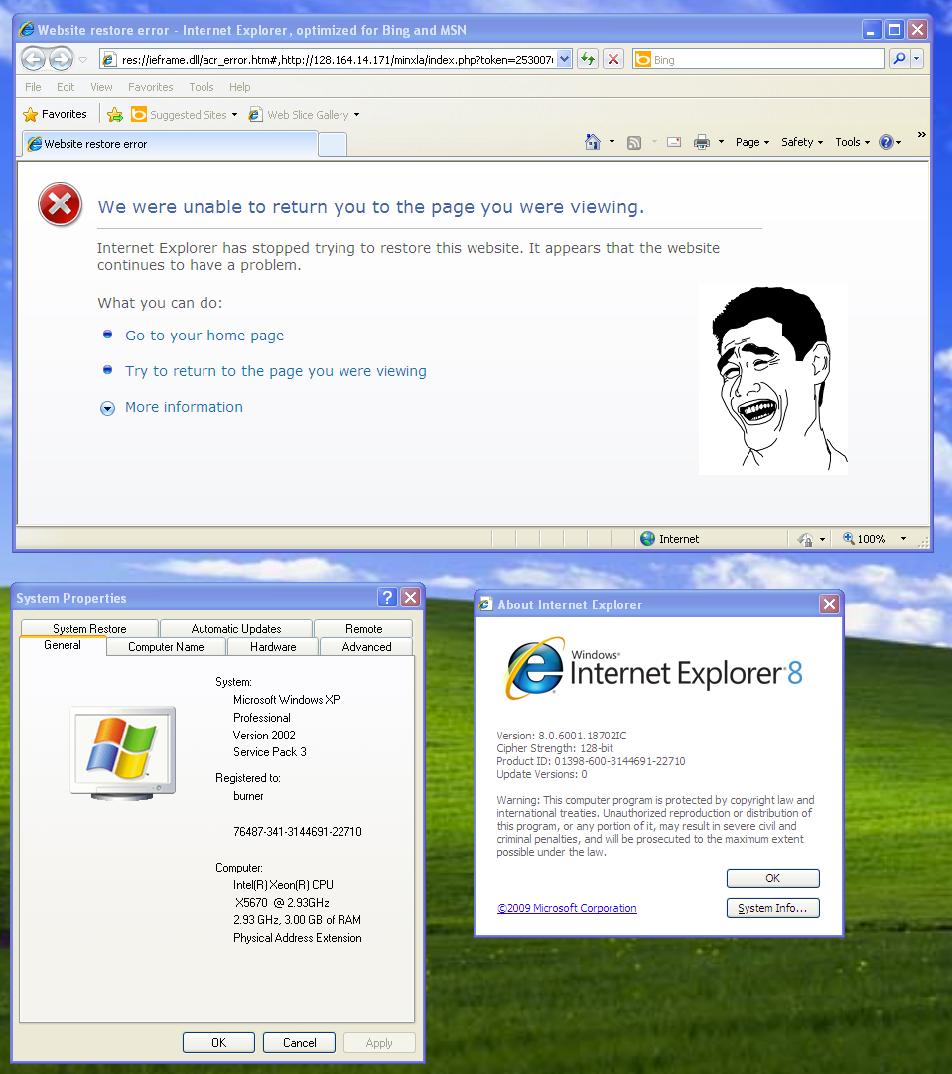
Yes, IE Dies

Slide 28
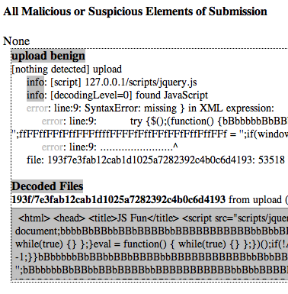
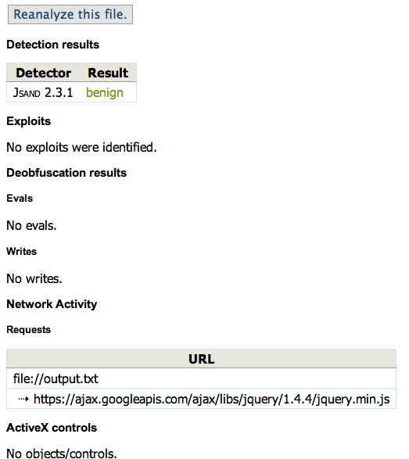
Nothing to See Here

Slide 29
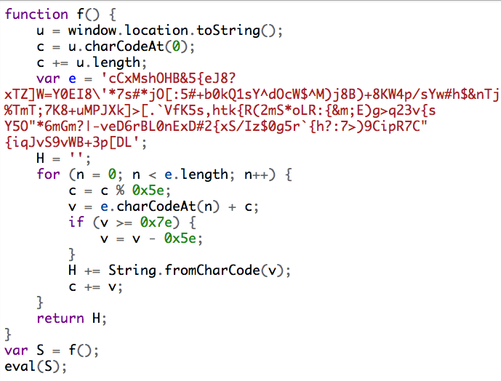
Modulus Encoding
Decodes depending on page/browser attributes
One-to-one character mapping
Faulty execution when debugging on JS sandbox websites
Can apply same techniques as other encoders (var names, try/catch, etc.)

Slide 30
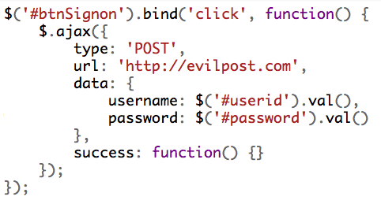
Encode This

Slide 31
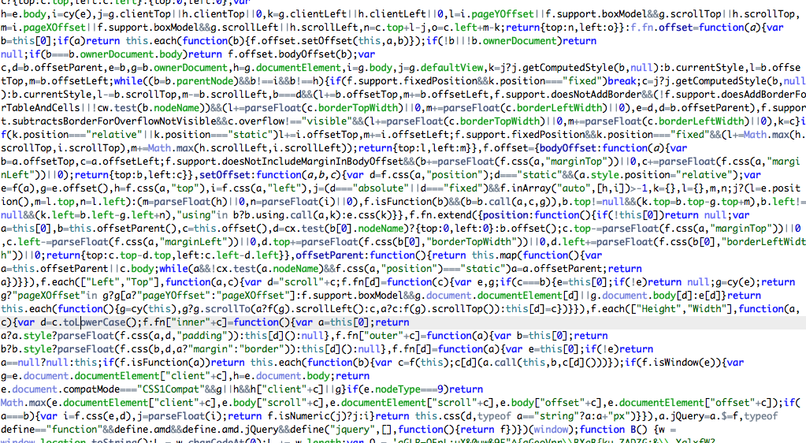
Hide in This

Slide 32
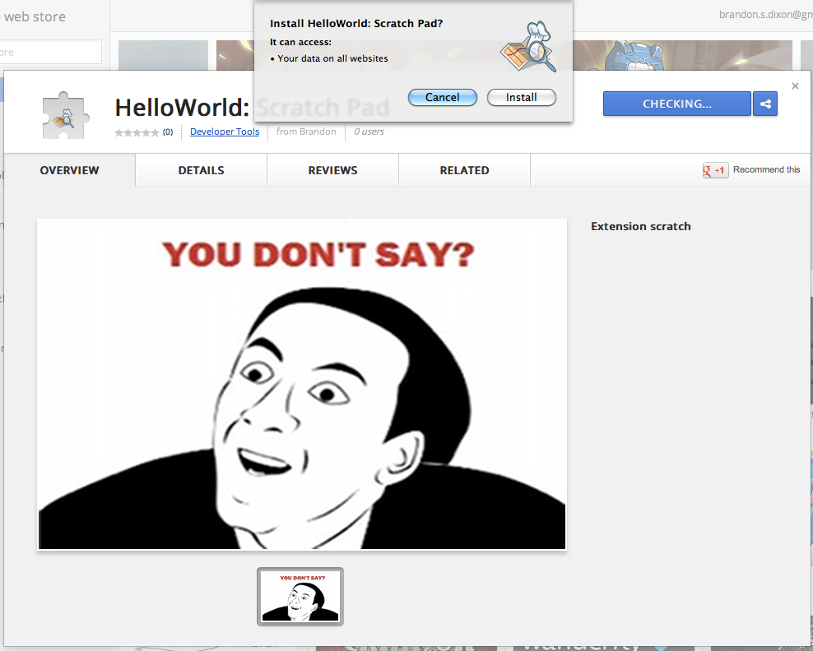
Own Browsers

Slide 33
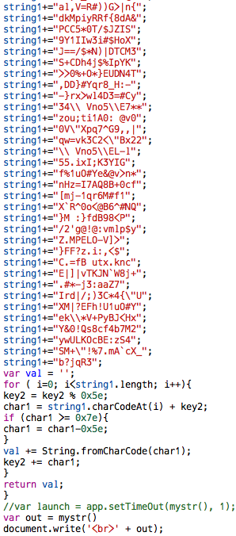
Thanks 2011-4369 0ay

Slide 34
Lessons Learned
IE sucks for writing malicious JavaScript
Test after every change (even minor)
Version off builds
Check character encodings before building
All browsers are not built equal
Understanding and doing are two different things
Stealing from APT attacks == great

Slide 35
Fork and Download
https://github.com/9b/doomsday_encoder/

Slide 36
Playground
Reverse Challenge
http://www.9bplus.com/redgift/direct.php
AJAX Delivery
http://www.9bplus.com/greengift/index.php?token=#######
Rapid Instance
http://www.9bplus.com/bluegift/direct.php

Slide 37
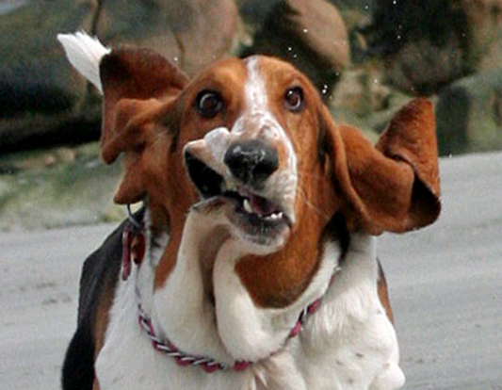
DEMO

Slide 38
Conclusions
Attackers will upgrade (some already started using AJAX)
We need to detect this now (browser emulation, AJAX path following, 3rd-party library awareness, etc.)
Chrome web store needs some chaos to fix these issues (it’s been years)

Slide 39

$$ GWU IS HIRING $$ GWU IS HIRING $$
Brandon Dixon
brandon@9bplus.com
www.9bplus.com
blog.9bplus.com
www.pdfxray.com
@9bplus
$$ https://www.gwu.jobs/postings/7735 $$

